Slide 1
Marketing & Retail Store : Capstone Project (C8 Batch - March 2022 – April 2023)
Group Members
Juned Sayyed
Shivangi Tripathi
Manish Gupta
Sangita Mishra

Slide 2
Introduction
OList is an e-commerce company that has faced some losses recently. It wants to manage its inventory very well so as to reduce any unnecessary costs that it might be bearing. It needs to identify the product categories to get rid of without significantly impacting business.

Slide 3
Objective
To identify top products that contribute to the revenue.
Analyze the customer purchase behavior to estimate what items are more likely to be purchased individually or in combination with some other products.
Provide recommendations for better inventory management so as to reduce any unnecessary costs.

Slide 4
Assumption
Orders:
Only the orders with order status as ‘delivered’ are considered for this case study since 97% of the records are successfully delivered.
The missing values for ‘order_approved_at’ are replaced with respective ‘order_purchase_timestamp’.
Similarly, the missing values for ‘order_delivered_timestamp’ are replaced with respective ‘order_estimated_delivery_date’.
Customer:
For redundant customer records, only the first occurrence is kept and the duplicated ones are removed.
Products:
The missing product category has been replaced with the mode i.e. ‘toys’ as almost 75% of the records belong to ‘toys’ category.
For product width, length, height and weight, as the data is right-skewed and there is no significant outlier, instead of using mean, the respective median values are used to replace the missing values.

Slide 5
EDA and Visualizations
Exploratory data analysis is performed on the OList data to identify various patterns in customer purchase behaviour. The visualizations are plotted using Tableau.

Slide 6
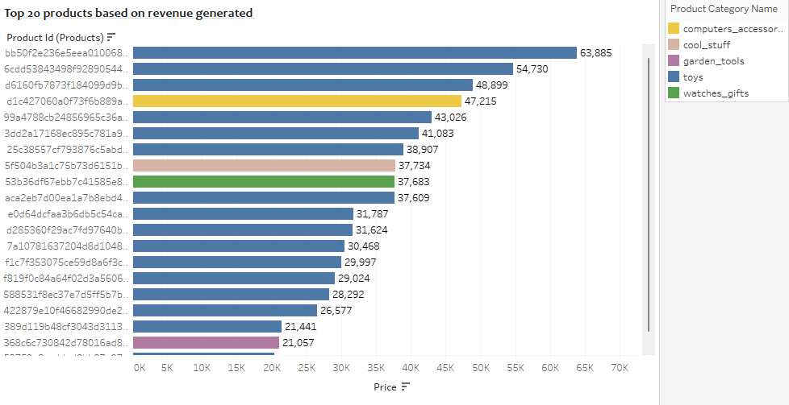
Top 20 products based on revenue generated
The highest revenue generated is 63,885.
The product that generated highest revenue belongs to the Toys category.
Most of the products in the top 20 list belong to the toys category.

Slide 7
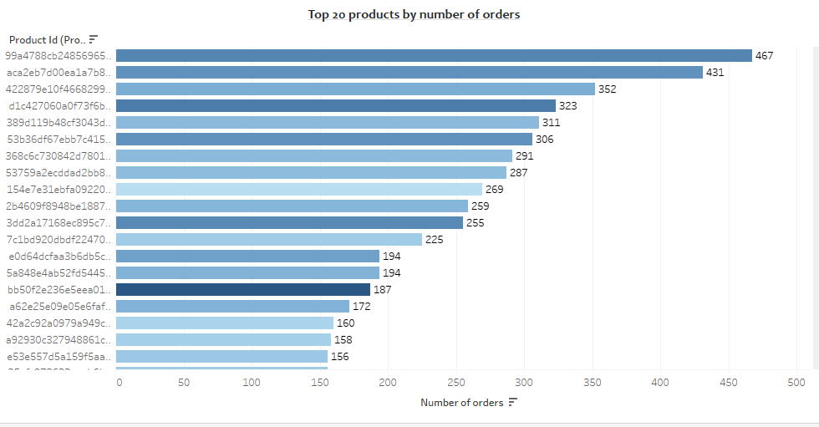
Top 20 products based on number of orders placed
The most ordered product has been purchased 467 times.
Some products are purchased frequently despite of the high price.

Slide 8
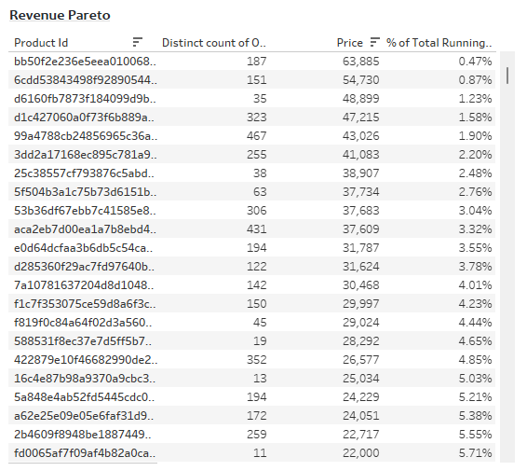
Total number of orders and percentage of total running revenue for each product
This Revenue Pareto shows the percentage of total running revenue, revenue generated and number of orders for each product id.
It can be used to identify the contribution of the products towards total revenue.

Slide 9
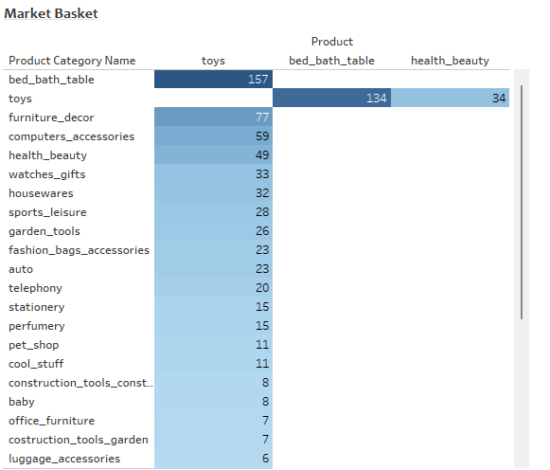
Market Basket Analysis Market Basket
Market basket analysis is performed to identify the frequently ordered category association.
Toys are often purchased with various other categories as shown in this Market Basket Analysis.

Slide 10
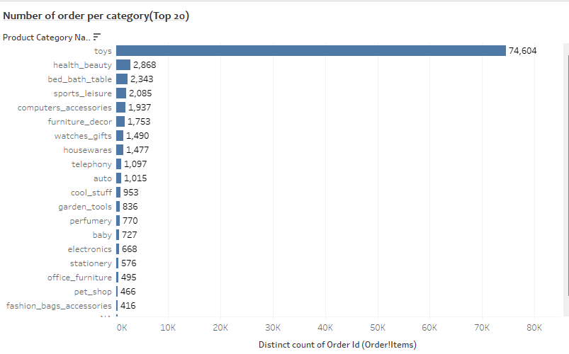
Number of orders per category
The Toys category is the most ordered category with a total 74,604 orders.
The categories here are filtered to show only the top 20 which are ordered more than 5 times.

Slide 11
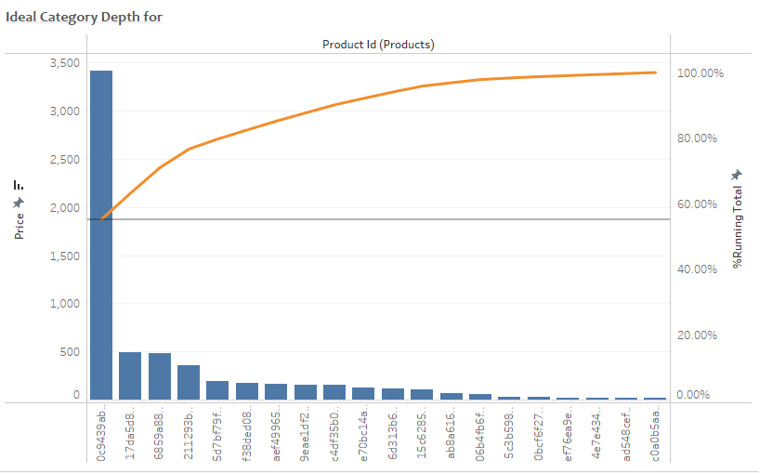
Ideal Category Depth
Revenue pareto analysis is performed to understand ideal category depth for each category.

Slide 12
Inferences
The category ‘toys’ is the most ordered category as it is ordered 74,604 times (76% of the total number of orders)
Apart from ‘toys’, the categories ‘health_beauty’, ’bed_bath_table’, ’sports_leisure’, ‘computer_accessories’ and ‘furniture_decor’ are the most frequently ordered categories. The above categories with ‘toys’ or/and with each other are most frequent in customer’s basket.
It is observed that despite of the high price, some products are frequently purchased by the customers.

Slide 13
Recommendations
Target customers who have children to boost up sales as they are most likely to purchase ‘toys’ which is the most ordered category.
Offer Promo-codes or discounts on frequently ordered category associations and the most ordered products to attract more customers.
Consider the ideal category depth to minimize the inventory cost by getting rid of the products which are seldom ordered and/or do not have a significant contribution to the total revenue under each product category

